Slide 1
TBA :
Teaching by Audience
John Unsworth
UC Boulder
August 2013

Slide 2
Teaching
My bit of the “future of digital humanities in higher education” is about teaching, the T in my TBA. And I bet you thought I just hadn’t come up with a title.
These brief remarks are meant to introduce some topics for discussion, in the area of teaching, as it affect and is affected by digital humanities. But I begin with learning.

Slide 3
Audience
I’ll start by offering a general observation that arises from my experience using digital humanities methods in teaching: students work differently when they have a real audience. Even graduate students often have relatively little experience writing for an audience, though DH has helped to change that, in various ways.

Slide 4
TBA and Students
Open digital content and social media provide great opportunities for students to communicate with real audiences: this is a very important and often overlooked benefit of teaching online, or designing student work to be presented online. FERPA be damned.
Example: Bestsellers Class

Slide 5
TBA as the lesson
Some of the most important lessons in digital humanities have to do with learning how to elicit from a collaborator, or from textual sources, an articulation of tacit knowledge. That’s all about listening to and understanding an audience—a core DH skill.
Example: evaluating literary text-mining methods (Bei Yu)

Slide 6
Comparative vocabulary analysis: KDD'01-05 conference paper abstracts and MUSE
“I examined the use of data mining keywords in the critical literature, like "model,” "pattern,” "association,” "correlation” etc. I'm surprised to find that literary scholars used as many models, patterns, and associations as, if not more than, computer scientists. So it looks to me the literary scholars are doing similar data mining things, except the basic elements are changed from numbers/symbols to humanistic elements like character, identity, language, social phenomena, etc.” (Bei Yu, email message to JMU)

Slide 7
Tools, Blobs, Abstractions
Tools offer interesting teaching opportunities, from blobs vs. data models to critical code studies, with lots of stops in between.
Tools also offer a view into evolving software idioms, from installable code to sandboxes to web services.
Example: Heller Markup exercise, using
  Special Collections
  Oxygen
  TEI Boilerplate

Slide 8
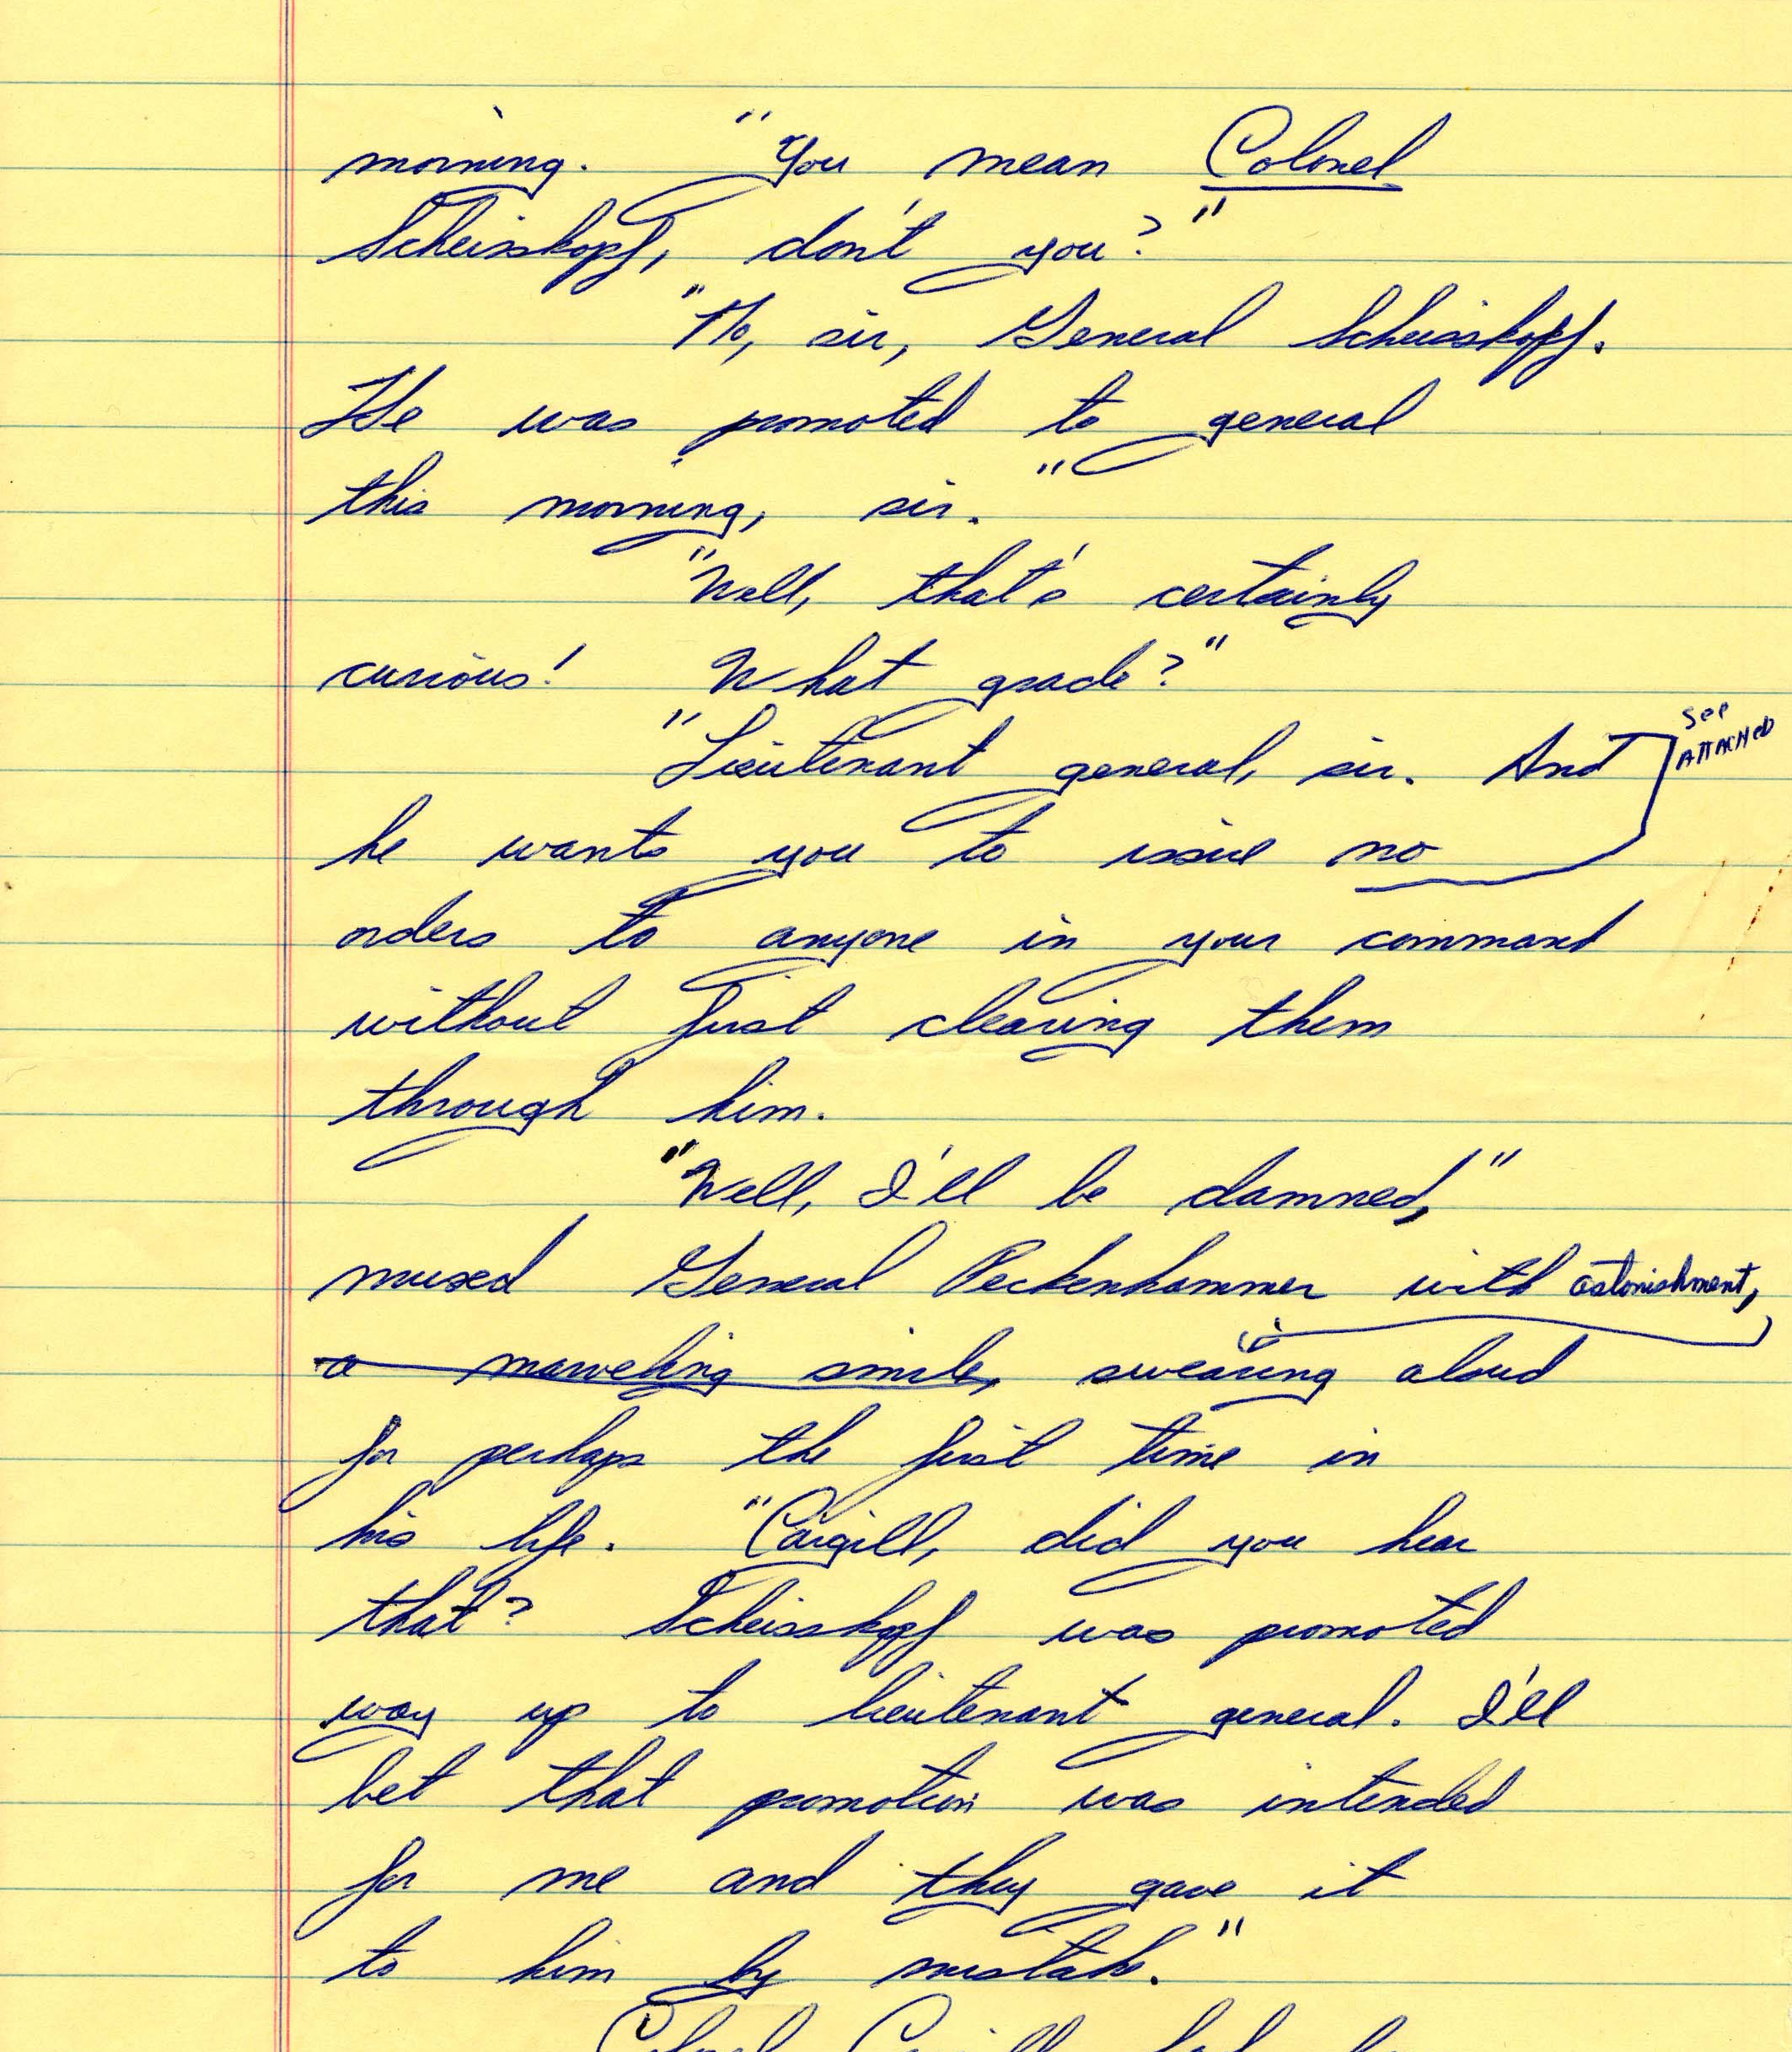
Catch 22, chapter 39: “General Scheisskopf
<teiHeader>
<fileDesc>
<titleStmt>
<title>Folder 84: Chapter XXXIX, "General Scheisskopf"</title>
</titleStmt>
<publicationStmt>
<p>Handwritten manuscript written by Joseph Heller sometime between 1945 and 1967. Written on college ruled yellow paper. Minimal damage and wear aside from minor tear on right-hand side of the manuscript.</p>
</publicationStmt>

Slide 9
Parallel Texts
Parallel texts, with visualization of the differences, provide an opportunity to talk about how texts evolve, to look at editing behavior, explore what motivates changes in the document, etc.
Examples:
Herman Melville’s Typee: A Fluid Text Edition
Using Juxta with Wikipedia entries

Slide 10
Text-mining
Understanding statistics is increasingly important for certain kinds of digital humanities work.
Ted Underwood’s blog is excellent at explaining key statistical concepts in plain language, for an audience of humanists
Voyant is a great tool for student experimentation
Examples: Voyant and Post-Apocalyptic Cities

Slide 11
Working with Visual Materials
Omeka exhibits offer an opportunity to introduce concepts including
  Descriptive metadata (items)
  Data models at the record level
  Administrative metadata (collections)
  Contextualization and its discontents
Example:
Use Omeka in your class
Ryan Cordell’s Norbertine class project

Slide 12
Working with Maps
Neatline, built on top of Omeka, offers a relatively easy way to mount exhibitions that include maps and other geo-referenced images. It also introduces the concept of layers, which is foundational in GIS.
Example: The Battle of Chancellorsville

Slide 13
Record vs. Item
Neatline’s conceptual relationship to Omeka also offers some interesting opportunities for discussing different ideas of records, items, and objects.
Example: Neatline documentation, “Records Overview”
Hosting options make this one pretty easy to pick up and work with, though you can download and install the software for free.

Slide 14
Up Next?
If this is what teaching DH looks like in the present, what’s the future look like?
  Access to larger collections and more robust tools (HTRC)
  More math, but also more diverse sets of interests, methods, backgrounds: see Tara McPhersonWhy are the digital humanities so white?”
  “Hopeful Monsters” (Kari Kraus): A future-oriented humanities

