Slide 1

Idiosyncrasy at Scale
@jamesjoyce: Man walks around Dublin. We follow every little detail of his day. He’s probably overtweeting.
Data Curation and the Digital Humanities
John Unsworth
December 7, 2010
IDCC #6
unsworth@illinois.edu

Slide 2
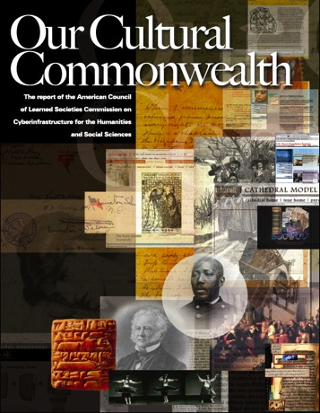
our cultural commonwealth
“Science and engineering have made great strides in using information technology to understand and shape the world around us. This report is focused on how these same technologies could help advance the study and interpretation of the vastly more messy and idiosyncratic realm of human experience.” (14)
Notes:
The idea of humanities data as messy and idiosyncratic isn’t a surprise, I hope: it’s part of why it seems so silly to talk about “humanities data” – as though we had a thermometer for the zeitgeist. Messy because it’s a human artifact, to start with, but messy also because human artifacts tend to be idiosyncratic. We are scaling up our digital representation of the cultural artifacts that remain from the past, and indeed, the biggest part of that job is ahead of us, with archives. Even more, though, we need to understand that these stages are just a prelude to the day when the object of interest doesn’t have to be digitized, because it was born digital—as not only almost all our documents and music and photos now are, but as our correspondence and diaries are as well. And surprising amounts of it seem to be surviving.

Slide 3
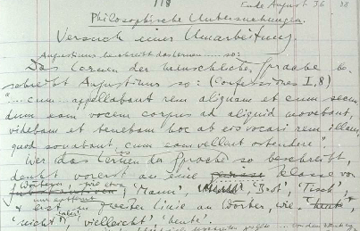
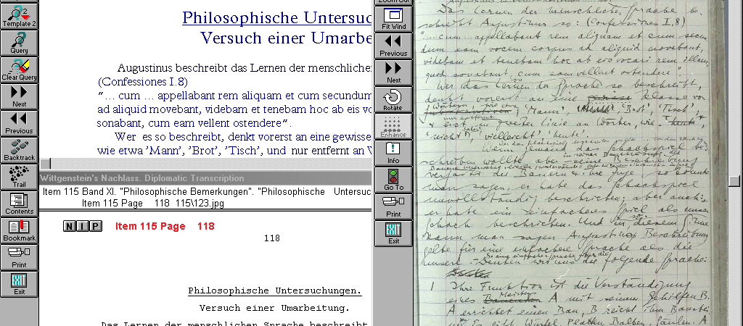
Messy ….
Claus Huitfeldt,”Electronic Textual Editing: Philosophy Case Study” http://bit.ly/dTw76L
Notes:
This is from Claus Huitfeldt’s essay in the 2004 MLA publication _Electronic Textual Editing_, in which he discusses some of the technical and editorial choices that confront an editor of philosophical texts—in this case, texts of Wittgenstein’s Nachlass. Taming the mess is part of the challenge, but the other part is recognizing that the mess has great value, as a mess.

Slide 4
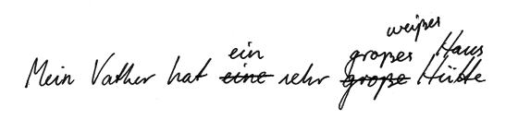
and idiosyncratic:
“An obvious requirement for a normalised reproduction is that orthographic errors are corrected. In this example one will have to mark up the misspelling ’Vather’ so that it can be rendered correctly as ’Vater’ in the normalised version. Admittedly, orthographic rules are not always clear, and texts are frequently written according to idiosyncratic or inconsistent orthographies. Further complication are that orthography variation is quite often a literary means of expression, and that orthography may in itself be an object of study. In electronic texts spelling affects not only readability, but also retrieveability. Therefore, standardisation is much more important in electronic than in traditional editions. While there may be a need to retain the original orthography, as in diplomatic transcription, there is also a need to standardise orthography to some set of uniform spelling rules.”
Notes:
In cleaning up the mess, you have to make some decisions that (for even the most doctrinaire) going to be difficult to generate by rule. Then there is the matter of weighing literal sense against less concrete connotations: is departure from the norm an error, or a data-point? I expect that one could map the same opposition of creativity vs. normalization in other areas of expression: art, dance, music. Now, though, retrieval is the precondition of use, and normalization is the precondition of retrieval. This may in fact simply be how the world works now, for most people, even if it’s still possible for some to work with materials that haven’t been digitized, haven’t been gathered from disparate locations, haven’t been made computationally tractable.

Slide 5
six laws to give us pause:
Scholars are interested in particular texts.
Analytical tools are only useful if they can be applied to texts that are of interest.
No single collection has all texts.
No two collections will be identical in format.
No one collection will be internally consistent in format.
Analytical tools need comparable texts in order to provide meaningful results.
Notes:
Scholars have a particular purpose in working with their materials, so particular materials are often important. These materials are often found in different collections, so if they have to be normalized to be retrieved to be worked with, we’re going to need to figure out the normalization part.

Slide 6
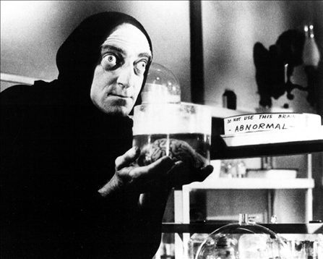
humanities data narratives include normalization
Therefore….
Lots of normalization, at very granular
levels. For example, with textual data,
normalization might apply to:
Spelling
Vocabulary
Punctuation (esp. hyphenation)
Chunking (paragraphs, pages, arbitrary chunks)
Markup
Metadata
Notes:
We normalize what is Abby Normal. And often we do it at the level of significant parts, not the whole. Interchangeable parts at this level of granularity is a demonstrated problem, in the long run.

Slide 7

a text-mining example
Staff, student or faculty at one of the Big Ten schools may use MONK with an augmented data set that includes all the texts in the public data set plus about a thousand works of British literature from the 16th through the 19th century, provided by The Text Creation Partnership (EEBO and ECCO) and ProQuest (Chadwyck-Healey Nineteenth-Century Fiction). To use MONK with this data set you will be required to authenticate using the CIC implementation of Shibboleth.
the MONK Project includes approximately 525 works of American literature from the 18th and 19th centuries, and 37 plays and 5 works of poetry by William Shakespeare provided by the scholars and libraries at Northwestern University, Indiana University, the University of North Carolina at Chapel Hill, and the University of Virginia. These texts are available to all users, regardless of institutional affiliation.
Notes:
A small-scale but real-life example: the Mellon-funded MONK project, which gathered texts from four universities and two commercial publishers, materials originally published over a three-hundred-year period, and digitized over decades, some into SGML, some XML, normalized it, and made those texts interoperable: Martin Mueller’s group at Northwestern was central to this part of the project, and particularly Phil Burns to the NLP parts.. I think this project sets a useful upper bound, actually, on the level of normalization you can imagine doing across text collections, at least today. A part of that cross-collection effort that should not be overlooked: Brian Pytlik Zillig’s XSL work on Abbot, a meta-xsl construct, that first constructs and then applies rules for normalization. Brian is Associate Professor and Digital Initiatives Librarian at the Center for Digital Research in the Humanities.

Slide 8
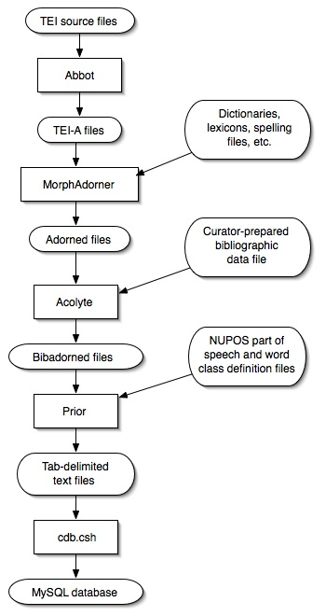
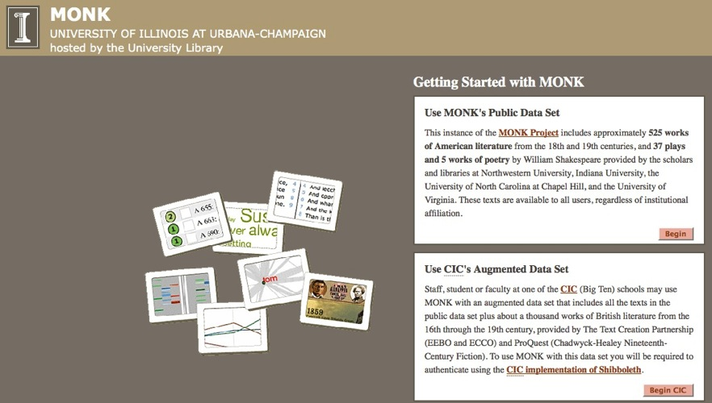
MONK Ingest:
1. Tei source files (from various collections, with various idiosyncracies) go through Abbot, a series of xsl routines that transform the input format into TEI-Analytics (TEI-A for short), with some curatorial interaction.
5. cdb.csh creates a Monk MySQL database and imports the tab-delimited text files.
4. Bibadorned files are processed by Prior, using a pair of files defining the parts of speech and word classes, to produce tab-delimited text files in MySQL import format, one file for each table in the MySQL database.
2. “Unadorned” TEI-A files go through Morphadorner, a trainable part-of-speech tagger that tokenizes the texts into sentences, words and punctuation, assigns ids to the words and punctuation marks, and adorns the words with morphological tagging data (lemma, part of speech, and standard spelling).
3. Adorned TEI-A files go through Acolyte, a script that adds curator-prepared bibliographic data
http://bit.ly/hyotgz
Notes:
So this is the trail of transformations that make up the provenance—but actually, only the latest chapter in the provenance—of the MONK datastore. The destination for this data was (is) an interface that allows some fairly limited but reasonably robust text-mining capabilities, and that allows you to build (out of the fairly modest but reasonably representative collection of 150M words) the workset you’re interested in working on.. It’s also an interesting example in that it is a mix of free and licensed texts, and that it’s using Shibboleth/InCommon (thanks, Mike Grady!) to control access to the licensed materials across 14 institutions.

Slide 9

Digitized as of 12/6/2010:
  7,483,715 total volumes
  4,227,702 book titles
182,782 serial titles
2,619,300,250 pages
278 terabytes
89 miles
6,081 tons
1,826,616 volumes (~24% of total) in the public domain
Notes:
In 2007, when we started MONK, Hathi Trust hadn’t yet been launched (that was 2008). And really, only about the time we finished MONK did texts begin to become available through an API from HT. But going forward, HT is obviously a central player in developing the research use of the digitized texts of our cultural heritage.

Slide 10
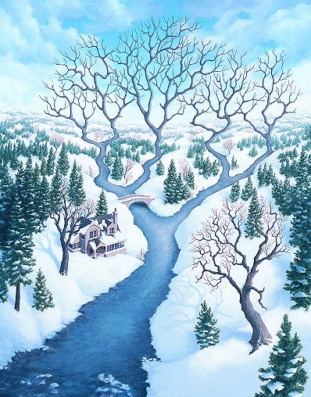
HathiTrust ≠ Single Source
HathiTrust materials will come from Google Books (from digitizing material contributed by the libraries to which the digitized data is returned), but they will also come from other past, current, and future digitization efforts, including the Open Content Alliance and various in-house efforts. So, expect continued collection-level idiosyncrasies.
“Tributaries,” Ron Gonsalves
Notes:
On the other hand, lest we leap to the conclusion that this will solve some big part of the normalization problem, we need to remember that HT is not single-source; not only other contributors than Google, but also Google from one decade to the next, will do things differently.

Slide 11
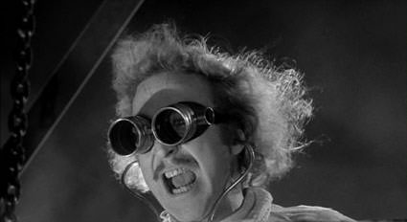
beyond normalization:
Correction of texts by users (e.g., distributed proofreading)
Correction or enriching of metadata by users
Sharing of representations (e.g., indices, databases, visualizations)
Publishing interpretations backed by data
Notes:
And there’s plenty beyond normalization, actually. When text is your data, and the digital version is produced by automated means, some users are going to care enough about the quality of the data to improve it. Others will be willing, or accidentally able, to enrich metadata for that text. And the re-processings of text have a value as well, on their own or as supporting material for something else.

Slide 12

HathiTrust Research Center
If approved and funded, it would have the task of supporting research with HT materials
Data curation would be a key element of its activities
Keeping one person’s solution from becoming another person’s problem will be a challenge.
Notes:
This is the sort of thing a HT Research Center might do.

Slide 13
key htrc attributes
Serves its users, giving priority to those from HT member institutions.
Recognizes humanities as a key constituency, but also recognizes key constituencies in social science, computer science, and other areas.
Knows the recipe for Stone Soup.
Can manage the copyright issues it can’t avoid
In the absence of a GB settlement, and with institutional budgets under stress, it may take some time to build this and make it sustainable, but if the community drives it, it will go.

Slide 14
dh answers: on data curation
In response to the above, I'd like also to propose that you not ask them to exclude embedded markup. It is doubtless useful to be able to access Unicode text versions of document data, but this is trivial to retrieve from any markup system; in the case of most marked-up documents, the bulk of the actual value of the document (in terms of scholarly work invested in creating the transcription) inheres in the markup itself. I think it is good practice to provide easy access to Unicode text versions of marked-up texts as part of an application that hosts and delivers them, and if the application itself is being curated, then this functionality needs to be supported by the curation system. --Martin
In December 2010, the Outreach Committee of the ACH (Association for Computers and the Humanities) will draft an open letter to the funders of digital humanities projects, advocating for the establishment of data curation or management plans and open source / open access guidelines for grant-funded DH. What should we be sure to address in such a letter?
Please do not ask them to mandate the use of any form of embedded markup for data curation. What should be archived for others to freely repurpose and reuse is not text embedded with the subjective judgements of individuals, or the programming instructions of today that will mean nothing tomorrow. The only mandate for format (if any) should be plain Unicode text. --Desmond
Notes:
On the topic of not having someone’s solution become someone else’s problem, here’s a very recent call for advice on the subject of humanities data curation, and the first two responses to that call.

Slide 15
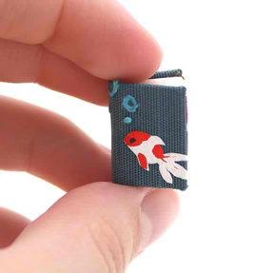
Humanities Data is a lot bigger than books
“The National Archives and Records Administration (NARA) is the Government agency that preserves and provides access to the U.S. Government's collection of documents recording the important events in American history. Our archival holdings number more than 10 billion pages of unique documents, many of them handwritten, and include formats such as maps, charts, aerial and still photographs, artifacts, and motion picture, sound, and video recordings.”
--National Archives and Records Administration, Strategy for Digitizing Archival Materials for Public Access, 2007-2016 http://bit.ly/c8EROP
Notes:
Actually, though, even the archival scale of data, which dwarfs the library scale, will itself be dwarfed by the twitter scale. Scholars in the humanities study human activity, human expression, and human artifacts, looking for human creativity. If we have access to more artifacts of that activity and expression, we’re going to want to study them. That’s going to present real challenges both in terms of the number of features that might be of interest to researchers, and in terms of the scale of collections, but it will also present some real opportunities for both the humanities and the social sciences. So, what can we learn from dealing with idiosyncrasy at scale that will help us to get scale itself right? Perhaps the balance point or the high water mark between the sharable representation of the data and the expressive one. Certainly, we can learn a great deal about normalizing and improving humanities data. I think that it will be a long process---actually, an open-ended one—to negotiate a shared understanding of where that high-water mark should be, and what counts as data vs. performance or perspective. Almost sounds like a profession, actually….

