Slide 1
Why are medievalists early adopters of information technology, and what can others learn from them?
MARGOT conference, Barnard College, New York, June 17, 2010
John Unsworth, Dean
Graduate School of Library and Information Science

Slide 2
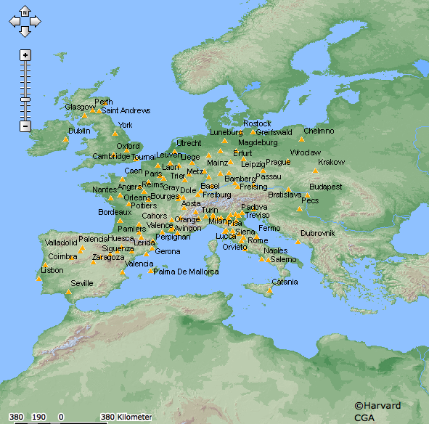
Topics:
Are medievalists early adopters?
What accounts for this early adoption?
When and why have medievalists moved on?
What does early adoption look like today?
What can medievalists learn from other fields?
What can other fields learn from medievalists?

Slide 3
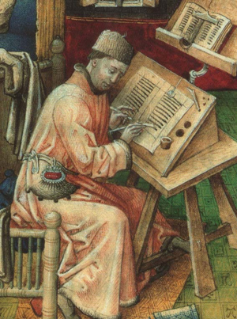
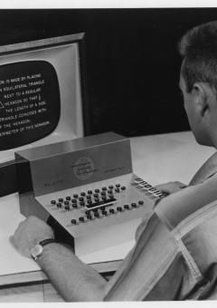
Are medievalists early adopters?
1946: ENIAC (vacuum-tube computer). U.S. Army
1951: Machine-generated concordance. R. Busa/IBM
1953: Computers for sale (IBM ships IBM 701)
1956: Busa establishes the Centro per l’Automazione
dell’Analisi Letteraria (CAAL)
1957: FORTRAN
1957: Magnetic-tape RSV Bible Concordance. J. Ellison/Remington Rand
1957: CAAL indexes the non-biblical Dead Sea Scrolls. Busa supervised transcription of 30,000 Hebrew, Aramaic, and Nabatean words.
1967: Thomas Aquinas text card-punching completed. R. Busa/IBM
1968: David Packard's program-produced Concordance to Livy.
[timeline adapted from “Roberto Busa, S.J., and the Invention of the Machine-Generated Concordance,” Thomas Nelson Winter, University of Nebraska-Lincoln: http://digitalcommons.unl.edu/classicsfacpub/70] and “FORMATTING the WORD of GOD,” ed. Valerie R. Hotchkiss and Charles C. Ryrie [http://smu.edu/bridwell/publications/ryriecatalog/titlepg.htm]

Slide 4
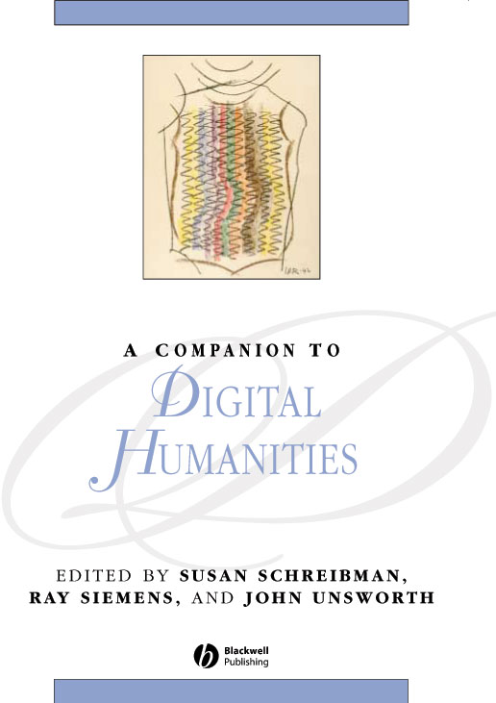
From Busa’s Foreword to the Blackwell Companion to Digital Humanities:
During World War II, between 1941 and 1946, I began to look for machines for the automation of the linguistic analysis of written texts. I found them, in 1949, at IBM in New York City. Today, as an aged patriarch (born in 1913) I am full of amazement at the developments since then; they are enormously greater and better than I could then imagine. Digitus Dei est hic! The finger of God is here! [….] In the course of the past sixty years I have added to the teaching of scholastic philosophy, the processing of more than 22 million words in 23 languages and 9 alphabets, registering and classifying them with my teams of assistants. Half of those words, the main work, are in Latin.

Slide 5
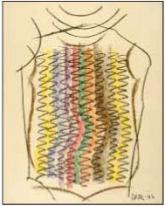
Busa’s Foreword, cont.
According to the perspective of technological miniaturization … the Index Thomisticus went through three phases. The first one lasted less than 10 years. I began, in 1949, with only electro-countable machines with punched cards. My goal was to have a file of 13 million of these cards, one for each word, with a context of 12 lines stamped on the back. The file would have been 90 meters long, 1.20 m in height, 1 m in depth, and would have weighed 500 tonnes. In His mercy, around 1955, God led men to invent magnetic tapes. The first were the steel ones by Remington, closely followed by the plastic ones of IBM. Until 1980, I was working on 1,800 tapes, each one 2,400 feet long, and their combined length was 1,500 km, the distance from Paris to Lisbon, or from Milan to Palermo.

Slide 6
Busa’s Foreword, cont.
I used all the generations of the dinosaur computers of IBM at that time. I finished in 1980 (before personal computers came in) with 20 final and conclusive tapes, and with these and the automatic photocompositor of IBM, I prepared for offset the 20 million lines which filled the 65,000 pages of the 56 volumes in encyclopedia format which make up the Index Thomisticus on paper. The third phase began in 1987 with the preparations to transfer the data onto CD-ROM. The first edition came out in 1992, and now we are on the threshold of the third. The work now consists of 1.36 GB of data, compressed with the Huffman method, on one single disk.

Slide 7
Index Thomisticus in print (behind Fr. Busa) and on the web (a fourth phase).

Slide 8
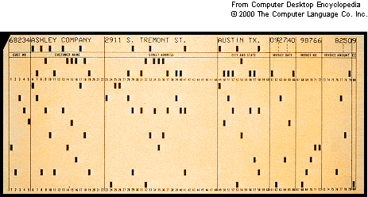
What accounts for this early adoption?
“Technological miniaturization” is important to you if you depend on tools like concordances, dictionaries, indices—reference works that are bulky and hard to use in print.
Granularity of the objects of attention may be in inverse proportion to the amount of material available (works vs. words; words vs. letters), but you may still have many objects of interest to track.
If your interest is in words themselves, and those words are in the roman alphabet, early computer technology (e.g., punch-cards) provided an adequate means of keeping track of words on a massive scale.

Slide 9
And in Busa’s case? Why?
[Busa] realized that a reader of a text cannot approach that text with his own conceptual verbal system but has to study the author’s. Therefore “a philological and lexicographical inquiry into the verbal system of an author has to precede and prepare for a doctrinal interpretation of his works.” … [T]he basic structures of human discourse are not generated by the so called “meaningful” words, but by all functional or grammatical words “which in my mind are not ‘empty’ at all but philosophically rich.” In these words, Busa sees the manifestation of “the deepest logic of being” and it is “this basic logic that allows the transfer from what the words mean today to what they meant to the writer.”
--Edward Vanhoutte, doctoral dissertation (in progress), qtd. from Humanist 20.165

Slide 10
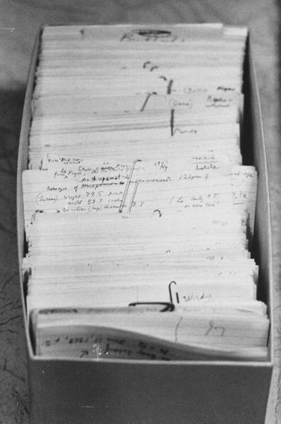
Why? “In.”
In his doctoral dissertation, published in 1949, Roberto Busa concentrated on the concept of presence in the works of Thomas Aquinas. Therefore, he wrote out by hand 10,000 3x5" cards each containing a sentence with the word “in” or a word connected with “in.” In doing so, he started to think about methods to automate linguistic analysis of texts [and to] plan for the Index Thomisticus, a lemmatized concordance of all the words in the complete works of Thomas Aquinas, “including conjunctions, prepositions and pronouns, to serve other scholars for analogous studies.”
--Edward Vanhoutte, doctoral dissertation.

Slide 11
Computerized Hermeneutics
“Grammar is the foundation of philosophy. Philosophy aims at unifying synthesis of the whole cosmos. Examining those grammatical words is the only possible path leading to and documenting such a synthesis, when near to its goal.
When I say that such hermeneutics is computerized, I mean computer assisted: the scholar makes the computer perform firstly all the operations of assembling, ordering, re-ordering, summarizing etc., and secondly all the searches for single data or groups of data which every heuristic strategy requires, one after the other”. --Busa qtd. In Vanhoutte

Slide 12
Computerized Hermeneutics (cont.)
“In fact, the specific function of the electronic organizer is that of carrying out censuses which are exhaustive, quantized and classified of the linguistic elementary micro-elements that form the framework of any text. Such a service is all the more valuable in that … every linguistic category is fuzzy or approximate and not rigid. Perhaps no linguistic category is absolute; perhaps all admit of exceptions. Only with the computer can the probability curves of such exceptions be specified in numbers and percentages, in order, furthermore, to identify what these are, and, finally, to check whether they are merely a noise that can be ignored or whether they carry a message, that is, are significant.” --Busa qtd. In Vanhoutte

Slide 13
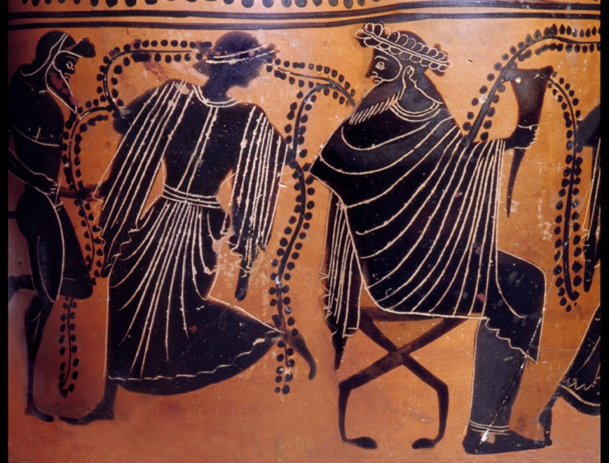
Any other early adopters? And why?
“Classicists have long been at the forefront of the Humanities in the use of computing for publishing, analysing, processing, and researching texts, objects, and data. This tendency can partly be explained with reference to two observations: (1) the complexity of the textual, historical, linguistic, material, and artistic sources that need to be considered in classical scholarship, and (2) the patchy coverage and fragmentary state of many of these same artefacts.”
. --Gabriel Bodard, Simon Mahony. "Though much is taken, much abides": Recovering antiquity through innovative digital methodologies: Introduction to the special issue. Digital Medievalist 4 (2008).

Slide 14
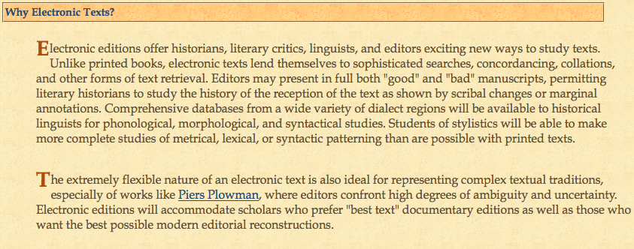
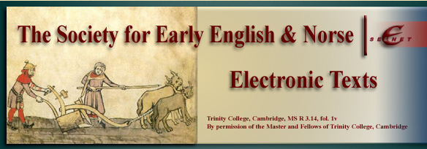
When and why have medievalists moved on?
Philological computing is alive and well…
… but now we also have increasingly sophisticated ways of
“computing the artifact”:

Slide 15
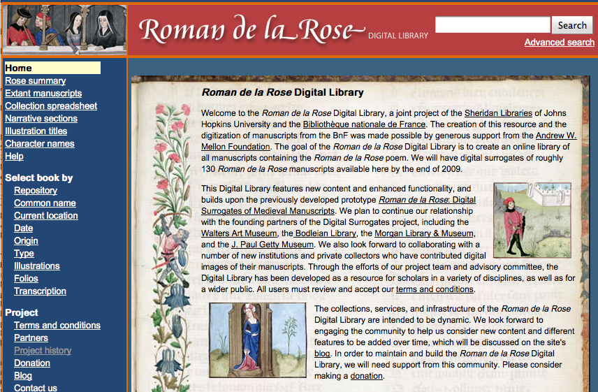
Image-based editions on CD and Web:

Slide 16
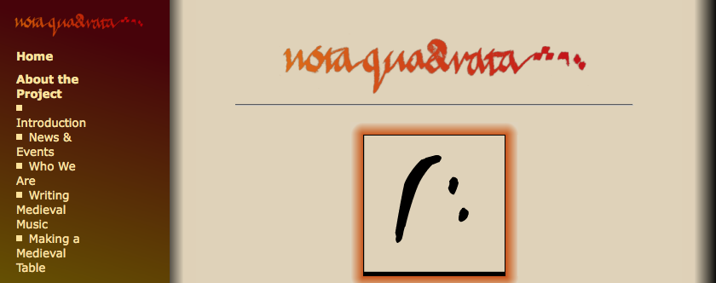
And databases of information about music:

Slide 17
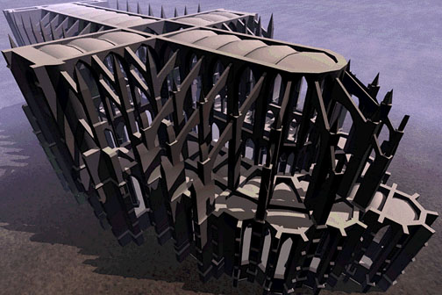
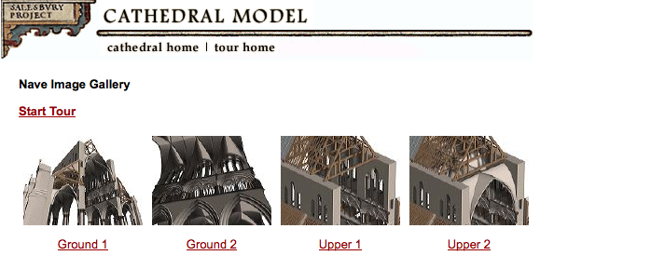
And models of medieval architecture:

Slide 18
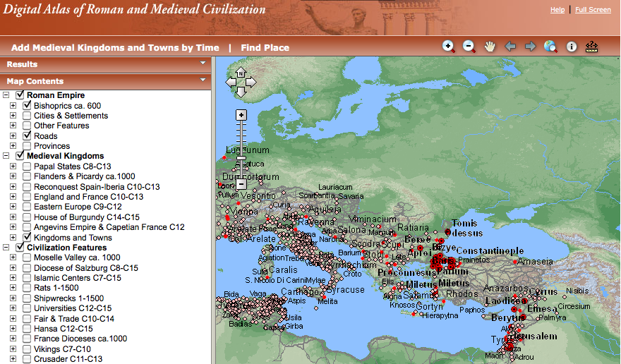
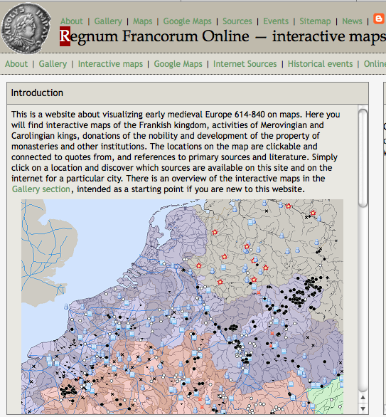
What does early adoption look like today?
Maps and historical GIS:

Slide 19
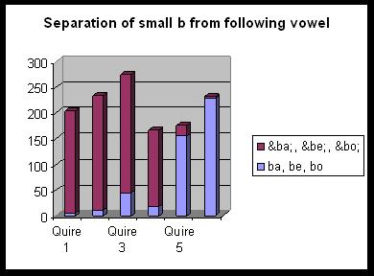
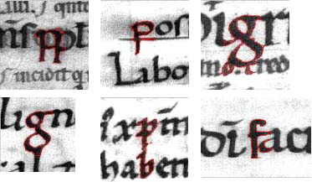
…and quantitative paleography:

Slide 20
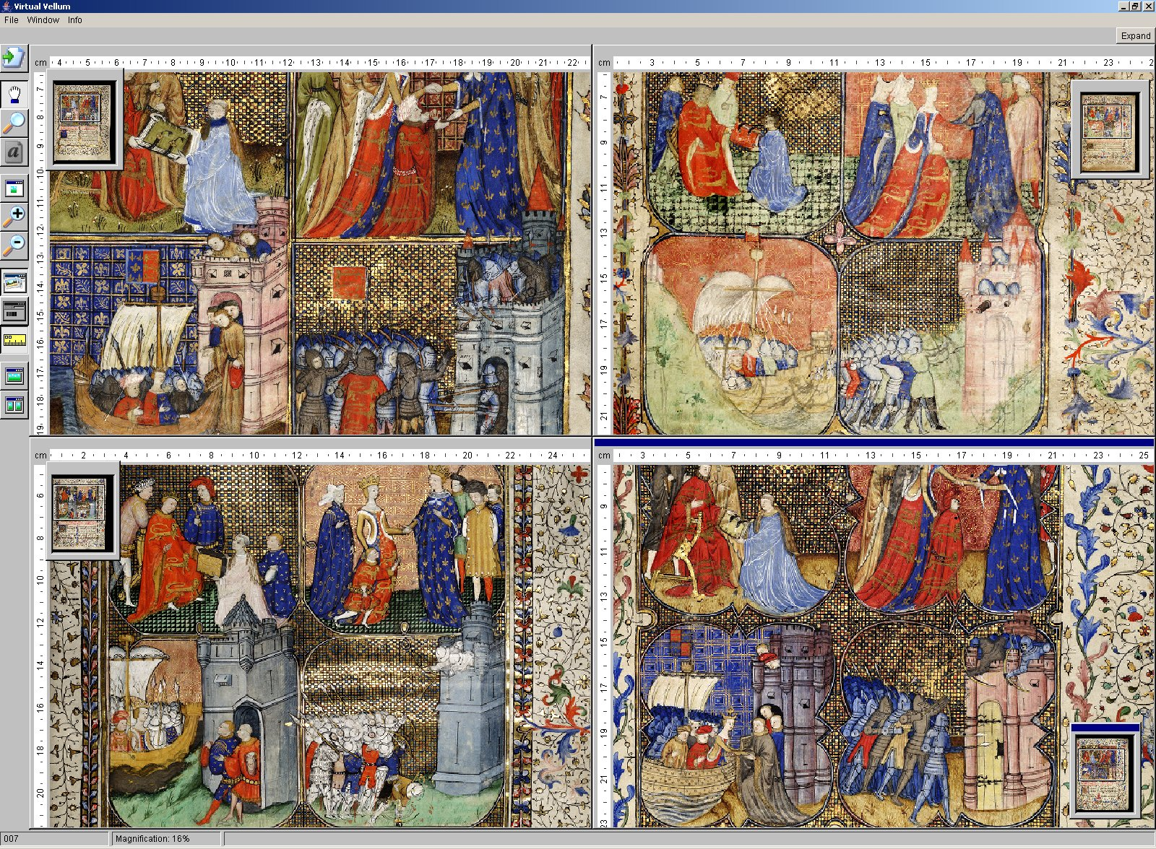
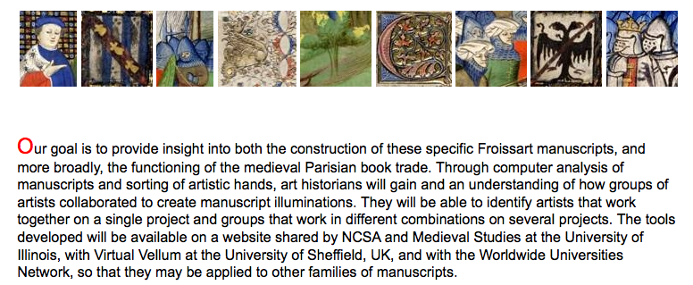
And other kinds of image analysis:

Slide 21
What can medievalists learn from other fields?
New methods for dealing with new kinds of data
New ways of looking at familiar data
New opportunities for expanding an already interdisciplinary field
New ways of teaching and learning
New facilities for collaborating and publishing

Slide 22
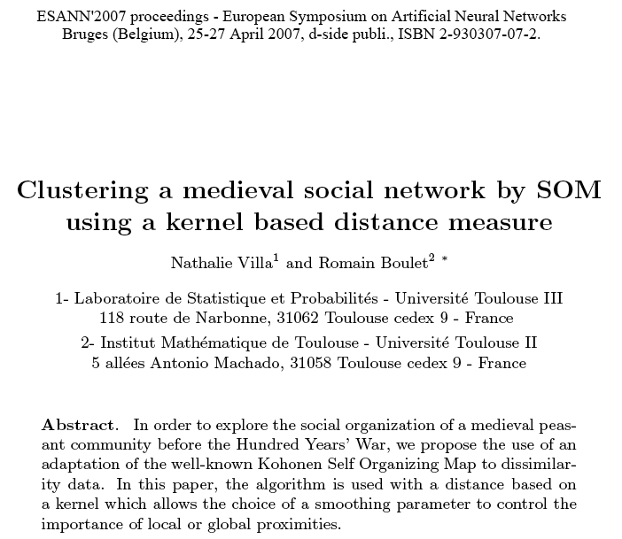
For example, medieval data-mining:

Slide 23
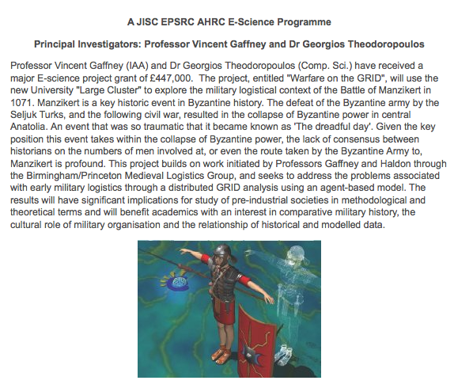
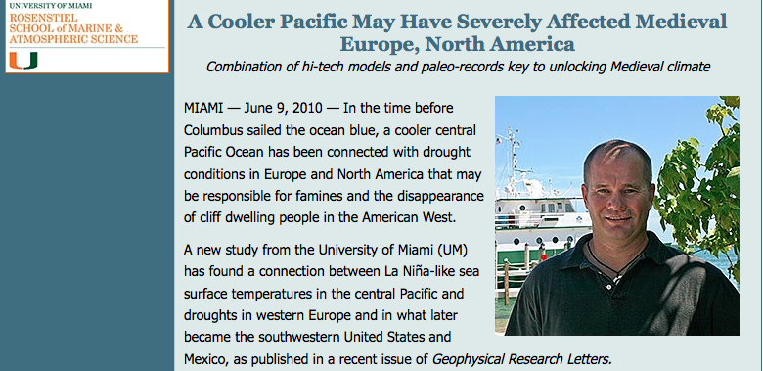
…or medieval supercomputing:

Slide 24
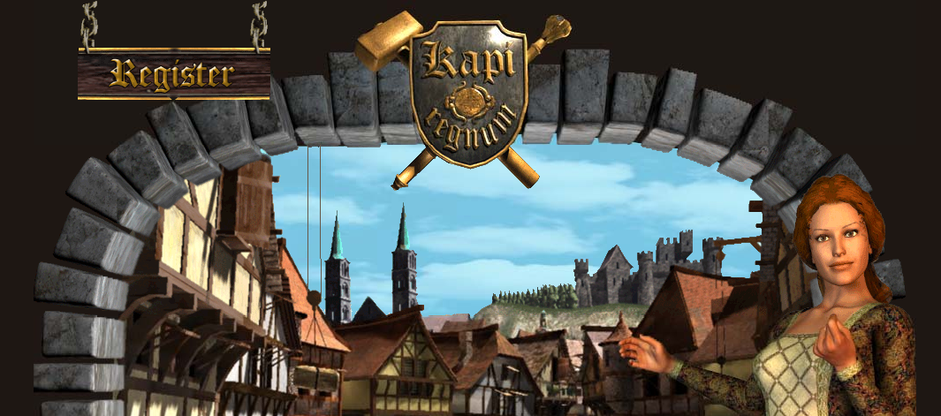
…or even medieval simulation like this:

Slide 25
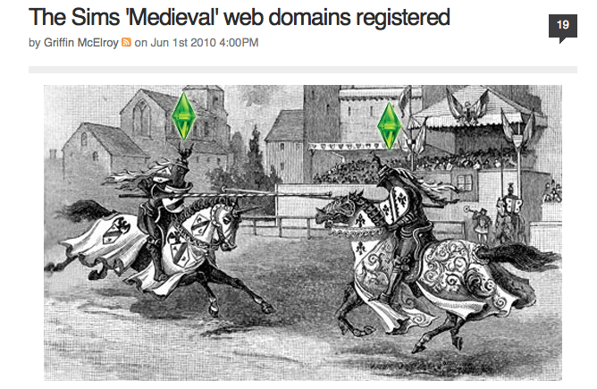
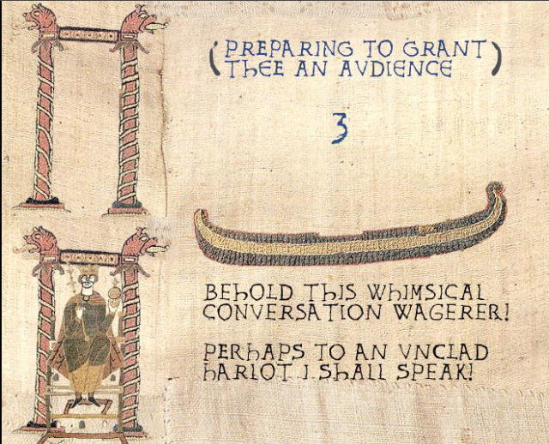
…but maybe not like this:

Slide 26
And even why medievalists may not be unique:
“…the needs of classicists are simply not so distinctive as to warrant a separate ‘classical informatics.’ Disciplinary specialists learning the strengths and weaknesses have, in the author's experience, a strong tendency to exaggerate the extent to which their problems are unique and to call for a specialized, domain-specific infrastructure and approach. Our colleagues in the biological sciences have been able to establish bioinformatics as a vigorous new field – but the biologists can bring to bear thousands of times more resources than can classicists. A tiny field such as classics, operating at the margins of the humanities, cannot afford a distinctive and autonomous history of its own. For classicists to make successful use of information technology, they must insinuate themselves within larger groups, making allies of other disciplines and sharing infrastructure.”
--Greg Crane, “Classics and the Computer: An End of the History,” in the Blackwell Companion to Digital Humanities.

Slide 27
What can other fields learn from medievalists?
That there was life before print, and there will be life after print;
That you may think more clearly about what comes next if you know something about what came before;
That technology is an affordance, not an imperative;
That you can avoid wasting a lot of time if you have an accurate sense of the strengths and limitations of current technology;
That if you put data first, data will last.

Slide 28
Shameless plugs:
Come to Digital Humanities 2010 at Kings College, London, July 7-10: http://dh2010.cch.kcl.ac.uk/
TEI announces AccessTEI, providing bulk pricing on text transcription (including manuscript materials, materials in non-roman alphabets, etc.) for projects at TEI member institutions: http://accesstei.apexcovantage.com/ -- now there’s a financial incentive for persuading your university, or university library, to join the TEI Consortium
Partner with iSchools (see http://www.ischools.org) for informatics research of various sorts, and for funding from IMLS (http://www.imls.gov/)
Consider attending (or sending students to attend) the next Digital Humanities Summer Institute (http://www.dhsi.org/) in beautiful Victoria, British Columbia.

