Slide 1
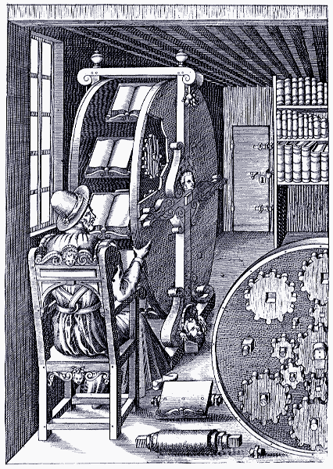
Reading at Library Scale: New Methods, Attention Prosthetics, Evidence, and Argument.
John Unsworth
Graduate School of Library and Information Science
University of Illinois
Book-wheel invented by Italian military engineer Agostino Ramelli in 1588

Slide 2
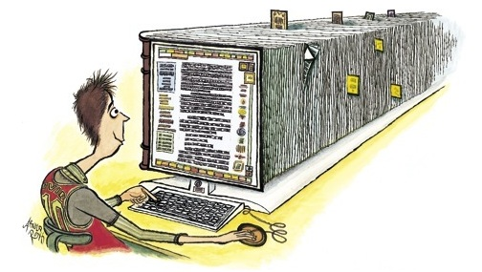
The book-wheel today:
http://www.newyorker.com/reporting/2007/02/05/070205fa_fact_toobin

Slide 3
How much can you read?
1 book a day x 365 days x 100 years = 36,500 novels
That’s the publishing output of Italy for one year (1996)
More recently, England published 206,000 new titles (2005); the U.S., 172,000 (2005); China, 136,226 (2007); Russia, 123,336 (2008).
--http://en.wikipedia.org/wiki/Books_published_per_country_per_year

Slide 4
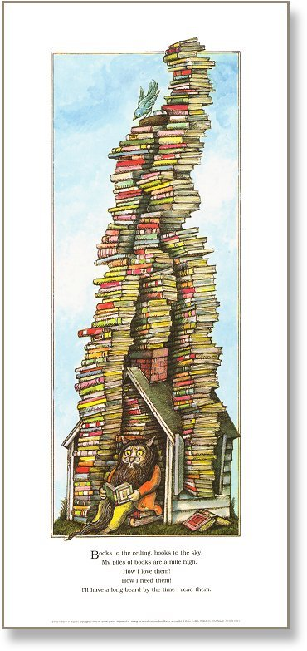
At that rate, to read the output of the English-speaking world for 2004 (375,000 new titles*), you’d need to live just over a thousand years.
*http://www.bowker.com/press/bowker/2005_1012_bowker.htm
Image credit: Arnold Lobel, Whiskers and Rhymes

Slide 5
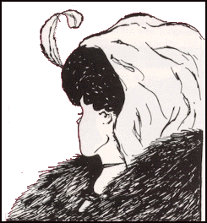
“. . . a canon of two hundred novels, for instance, sounds very large for nineteenth-century Britain (and is much larger than the current one), but is still less than one per cent of the novels that were actually published... And it's not even a matter of time, but of method: a field this large cannot be understood by stitching together separate bits of knowledge about individual cases, because it isn't a
sum of individual cases: it's a
collective system, that should be
grasped as such, as a whole.”
Franco Moretti, Graphs, Maps, Trees, 2005
Image: gestalt perception example, public domain

Slide 6
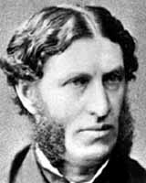
What Did We Used to Do?
Traditionally, we used the canon to solve this problem:
“[Culture seeks] to make the best that has been thought and known in the world current everywhere…” (Matthew Arnold, Culture and Anarchy).

Slide 7
Then along comes
With a mission that sounds almost like Arnold’s, if Arnold had been a mad librarian:
“…to organize the world's information and make it universally accessible and useful…”
Next thing you know, they’re digitizing millions of books: at least 10 million by now, probably more; eventually, 30 million or so.

Slide 8
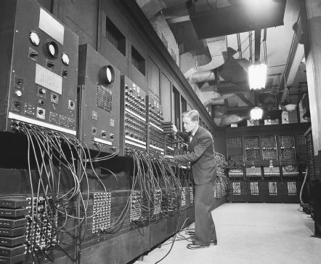
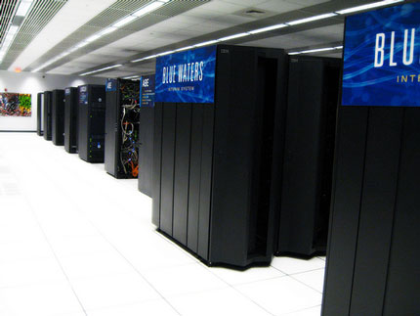
Who can read 30 million books?

Slide 9
To read at library scale, we need:
Computers as attention prosthetics, to assist us in keeping track of the little elements that make up big patterns across many books
A new appreciation for evidence in literary criticism, especially evidence that goes beyond the anecdotal to reach statistical
significance
A new sense of argument that
is skeptical with respect
to method.

Slide 10
Metadata Offer New Knowledge

Slide 11
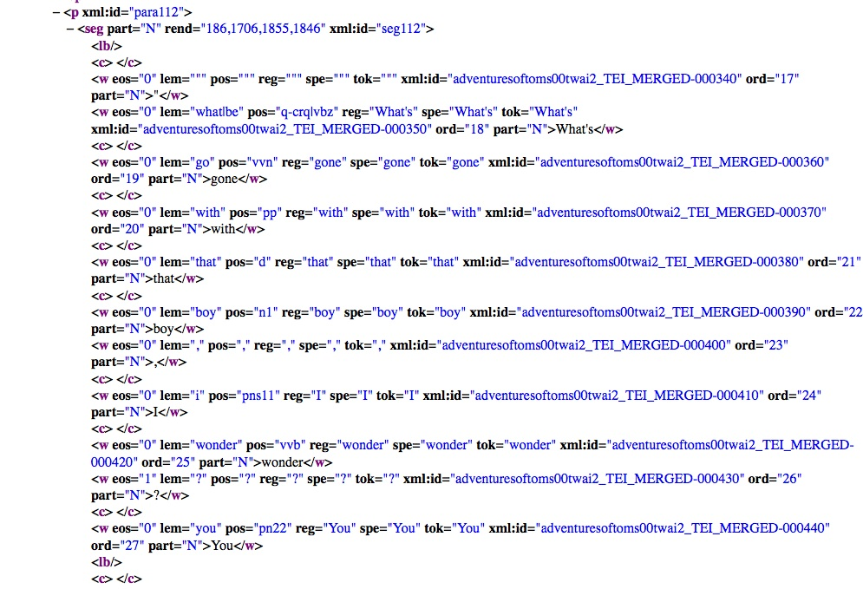

Slide 12
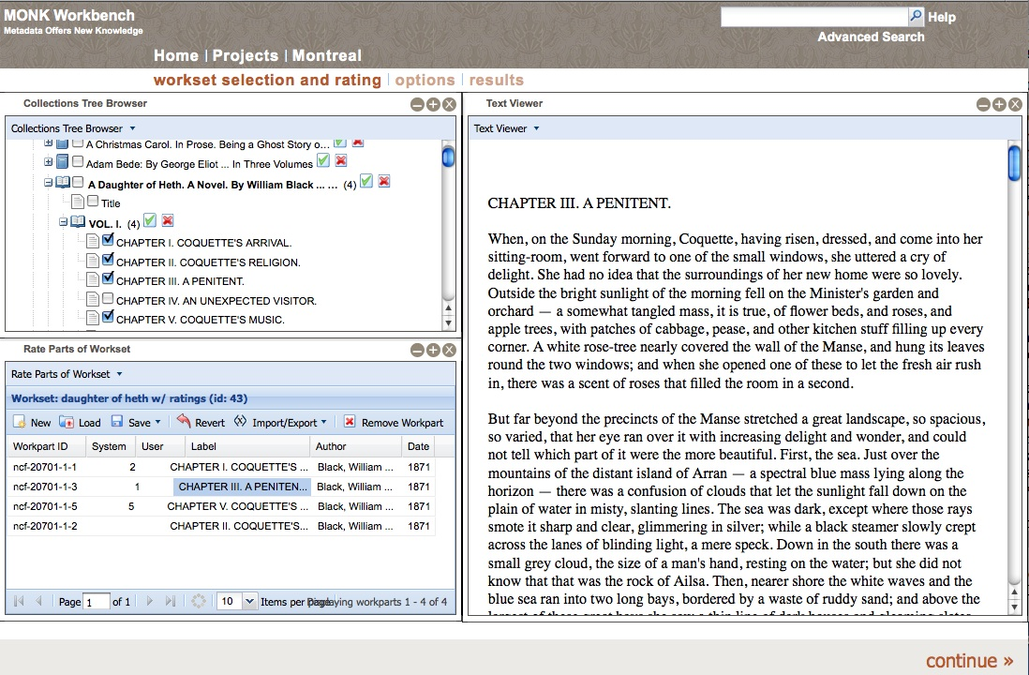

Slide 13
Dunning's log likelihood ratio . . . supports a 'figure and ground' operation where you choose one set of texts or words, called the Analysis Corpus, compare it with another set of texts or words, the Reference Corpus, and find words that are, in comparison with the Reference corpus, disproportionately common or rare in the Analysis Corpus.
Martin Mueller, Notes toward a user manual of MONK https://apps.lis.uiuc.edu/wiki/display/MONK/Notes+towards+a+user+manual+of+Monk

Slide 16
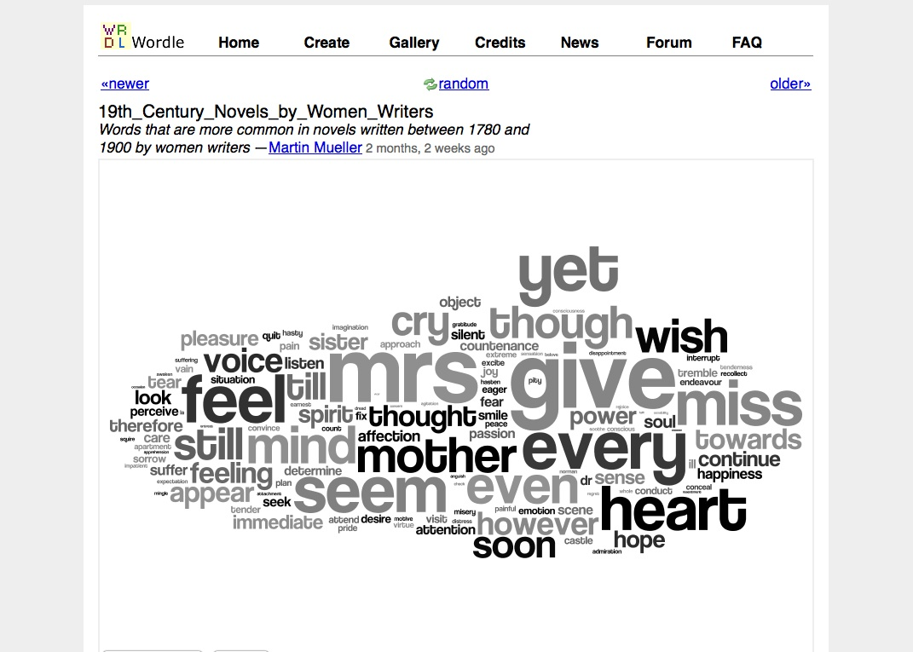

Slide 17
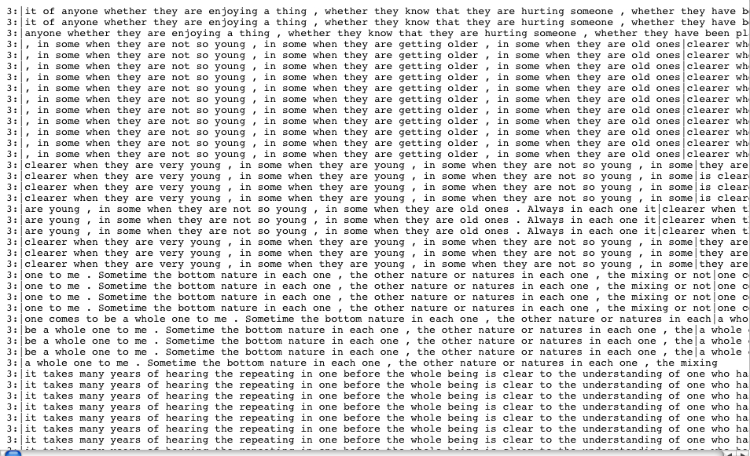

Slide 18
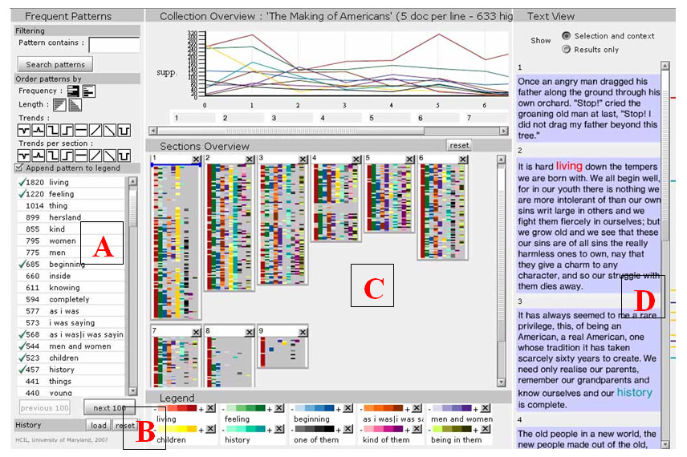

Slide 19
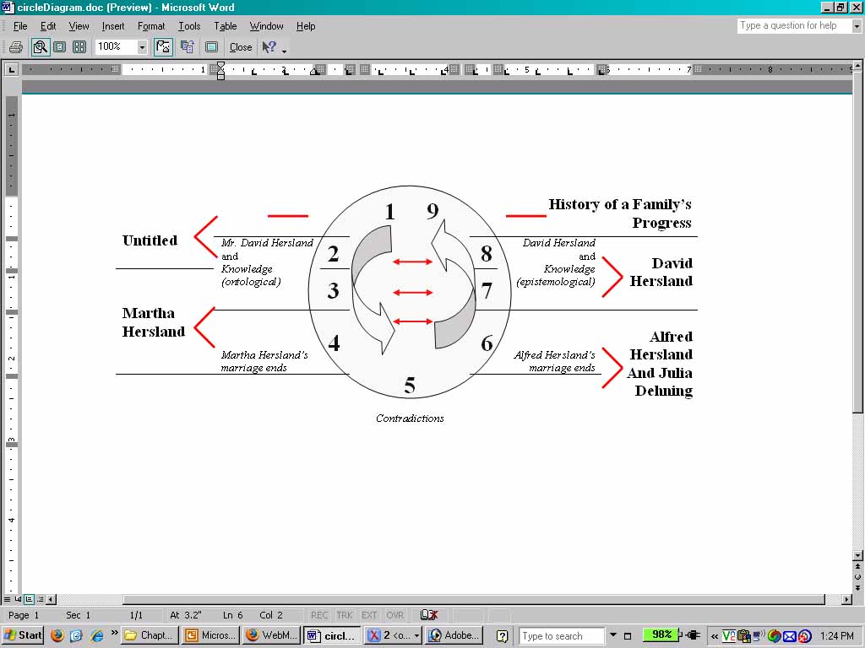

Slide 20
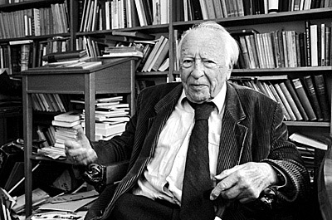
A person who is trying to understand a text is always projecting. He projects a meaning for the text as a whole as some initial meaning emerges in the text. Again, the initial meaning only emerges because he is reading the text with particular expectations in regard to a certain meaning. Working out this fore-projection, which is constantly revised in terms of what emerges as he penetrates into the meaning, is understanding what is there.
--Hans Georg Gadamer, Truth and Method (qtd. As the headnote in Sculley and Pasanek, “Meaning and Mining”

Slide 21
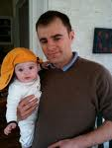
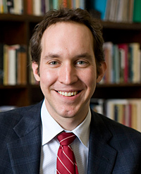
The virtue of automated analysis is not ready delivery of objective truth, but instead the more profound virtue of bringing us up short, of disturbing us in our preconceptions and our basic assumptions so that we can exist, if only for a moment, in uncertainties, mysteries, and doubts. Should we learn to forestall interpretation, we may come to revise our prejudices, theories, and fore-projections in terms of what emerges.
“Meaning and Mining: the Impact of Implicit Assumptions in Data Mining for the Humanities,” by D. Sculley and Bradley M. Pasanek. Literary and Linguistic Computing December 2008; Vol. 23, No. 4

Slide 22
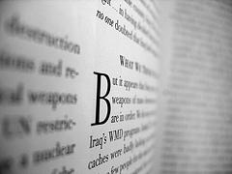
Best Practices for Humanities Text-Mining Suggested by Sculley & Pasanek:
Make assumptions explicit
Use multiple representations and methodologies
Report all trials (including failures)‏
Make data available and methods reproducible
Engage in peer review of methodology

